Slide 2
Barbiturates

Slide 3
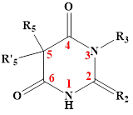
General structure The barbiturate are 5,5’-disubstituted barbituric acid * The structure of 5,5-disubstituted barbituric acids reveals their acidic character.

Slide 4
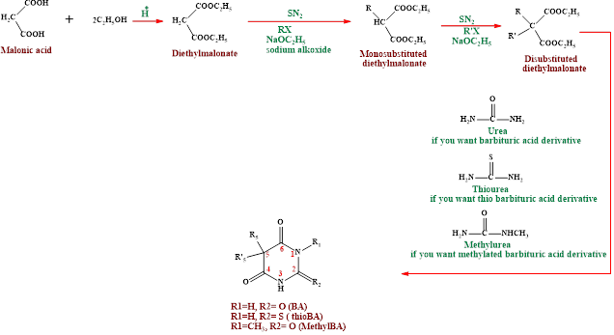
General procedure for barbiturate preparation

Slide 5
Factor effecting lipophilicity of barbituric acid 1.Those without methyl substituents on the nitrogen(N1 or N3) have pK_{a}s of about 7.6; those with a methyl substituent have pK_{a}s of about 8.4. The free acids have poor water solubility and good lipid solubility. 2.The two hydrocarbon substituents on the 5 position. 3. The 2-thiobarbiturates the sulfur atom increases lipid solubility.

Slide 7
Sodium salts of the barbiturates are readily prepared and are:- * Water soluble. * Their aqueous solutions generate an alkaline pH. *A classic incompatibility is the addition of an agent with an acidic pH in solution, which results in formation and precipitation of the free water-insoluble disubstituted barbituric acid. * Sodium salts of barbiturates in aqueous solution decompose at varying rates by base-catalyzed hydrolysis, generating ring-opened salts of carboxylic acids.

Slide 8
Structure-Activity Relationships (SAR)

Slide 9
1.The barbituric acid is 2,4,6-trioxohexahydropyrimidine, which lacks CNS depressant activity. So the replacement of both hydrogens at position 5 with alkyl or aryl groups confers the activity. Both hydrogen atoms at the 5-position of barbituric acid must be replaced. This may be because if one hydrogen is available at position 5, tautomerization to a highly acidic trihydroxypyrimidine (pK_{a} ∽4) can occur. Consequently, the compound is largely in the anionic form at physiological pH, with little nonionic lipid-soluble compound available to cross the blood-brain barrier.

Slide 10
2. Increase the length of the alkyl chain of R5 group at C-5, increasing potency until 5 or 6 carbon atoms after that it may cause convulsions. This property due to increase in lipophilicity. 3. Branched or unsaturated chain at C-5 will produce shorter duration of action than saturated chains containing the same number of carbon atoms. This occur because of:- a- Decrease in the lipophilicity b-Increase in the ease of metabolic attack and conversion to more polar inactive metabolite. 4. Compound having an alkyl group at N-1 or N-3 position have shorter onset and duration of action, because the N-CH₃ group result in a weak barbituric acid (e.g hexobarbital., pKa= 8.41) as compared with N-H group (e.g., pKa= 7.6). since the weaker acid is highly unionized lipid soluble at plasma pH so its rapidly enter CNS and rapidly accumulate in neutral fat.

Slide 11
5. Replacement of C=O at C2 by C=S(2- thioarbiturate) have a very short duration of action because the lipid/water partition coefficient is extremely high, promoting depotization. 6. The effect of the number of carbon atoms contained at the group substituented at C-5 on duration of action. a-When total number of carbon atoms of R5 and R’5 equal to (7-9) it has rapid onset and short duration of action. b-When the total number of carbon atoms at C-5= 4 it has slow onset and long duration of action, this occur when we have (2ethyl) groups or one ethyl and one phenyl group, like Phenobarbital. This phenyl group has water solubility more than expected from a 6-carbon chain which is similar to water solubility of C3, C4 straight chain. c-Intermediate onset and duration of action (C5-C7) carbon atom.

Slide 14
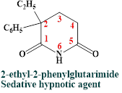
Miscellaneous Sedative-Hypnotics A wide range of chemical structures (e.g.. imides. amides, alcohols) can produce sedation and hypnosis resembling those produced by the barbiturates. 1. Amides and imides Glutethimide 2. Alcohols and Their Carbamate Derivatives Ethanol is a sedative hypnotic agent, but many problems associated with chronic used of alcohol (chronic alcoholism)

Slide 15
SAR 1. CNS depressant potency increases with increase M.W, up to eight carbon atoms, with activity decreasing there after. 2. Branching of the alkyl chain increase depressant activity and, in an isometric series, the order of potency is tertiary > secondary > primary. This may be because tertiary and secondary alcohols are not metabolized by oxidation to the corresponding carboxylic acids. 3. Replacement of a hydrogen atom in the alkyl group by a has an effect equivalent to increasing the alkyl chain and for lower M.W alcohol increase potency. 4. Carbamylation of alcohols generally increases depressant potency. Carbamate groups are generally much more resistant to metabolic inactivation than hydroxyl functions.

Slide 16
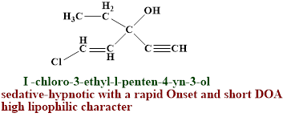
Examples Ethchlorvynol

Slide 17
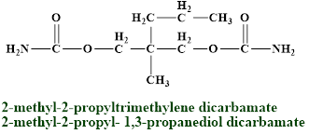
b-Meprobamate Uses:- Antianxiety agent. Sedative—hypnotic. The drug is effective against absence seizures and may worsen generalized tonic—clonic seizures. Meprobamate is also a centrally acting skeletal muscle relaxant.

Slide 18
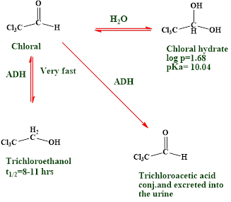
Aldehydes and their derivatives a-Chloral Hydrate S/E:- Chloral hydrate is a weak acid because its CCl₃ group is very strong electron withdrawing. A 10% aqueous solution of chloral hydrate has pH 3.5 to 4.4, which makes it irritating to mucous membranes in the stomach. As a result, GI upset commonly occurs for the drug if undiluted or taken on an empty stomach.

